Slide 1
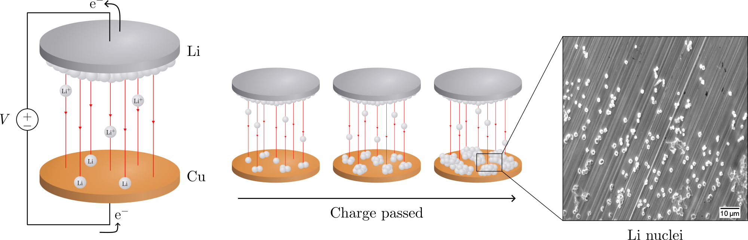
Electrochemical deposition of lithium on copper
Gottfrid Olsson
2024-05-21

Slide 2
PLAN: 25 minute presentation
Introduction:
Importance of batteries, improvements LMB>LIB (fig.), problems non-uniform growth (fig + in-depth), purpose of this thesis
Theory:
Homogenous nucleation theory; main results (fig.), how does eta impact r and N (fig.)?
Methods:
Cell assemblies (note importances; wave spring, no pressure); cycling protocol (fig.)
Results:
passivation of Cu; J-dep.; pressure (C-cell and T-cell, r & angle dep. and morphology)
Conclusion: 2 min
Passivation, J-dep. and pressure to achieve uniform deposition in LMBs
(Opposition and Questions from audience)

Slide 3
Batteries!

Slide 4
Non-uniform deposition problems

Slide 5
Purpose of this thesis
Investigate pressure, current, passivation

Slide 6
Nucleation theory

Slide 7
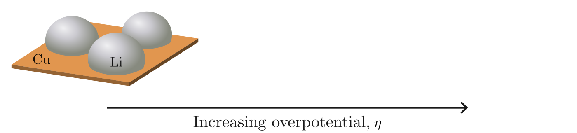
Nucleation theory
r ∝ η ⁻¹
N ∝ η ³

Slide 8
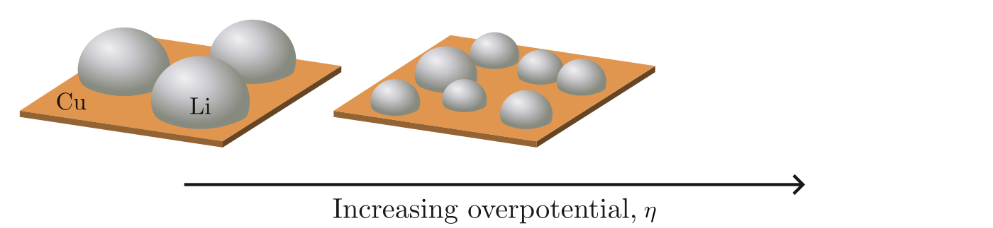
Nucleation theory
r ∝ η ⁻¹
N ∝ η ³

Slide 9
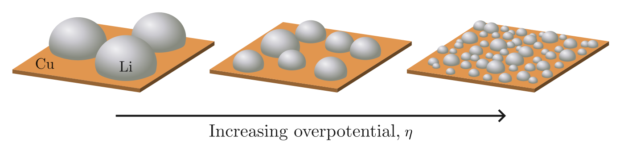
Nucleation theory
r ∝ η ⁻¹
N ∝ η ³

Slide 10
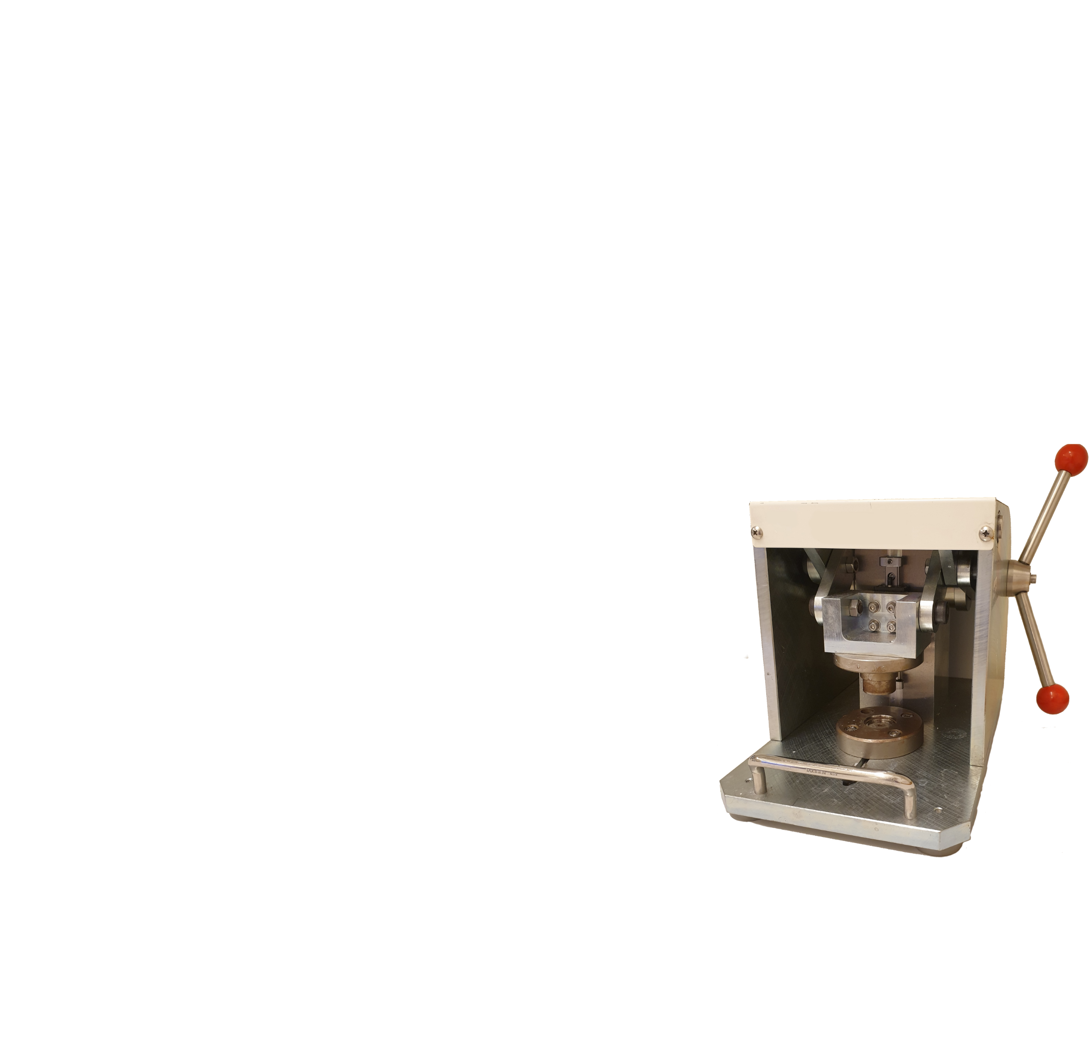
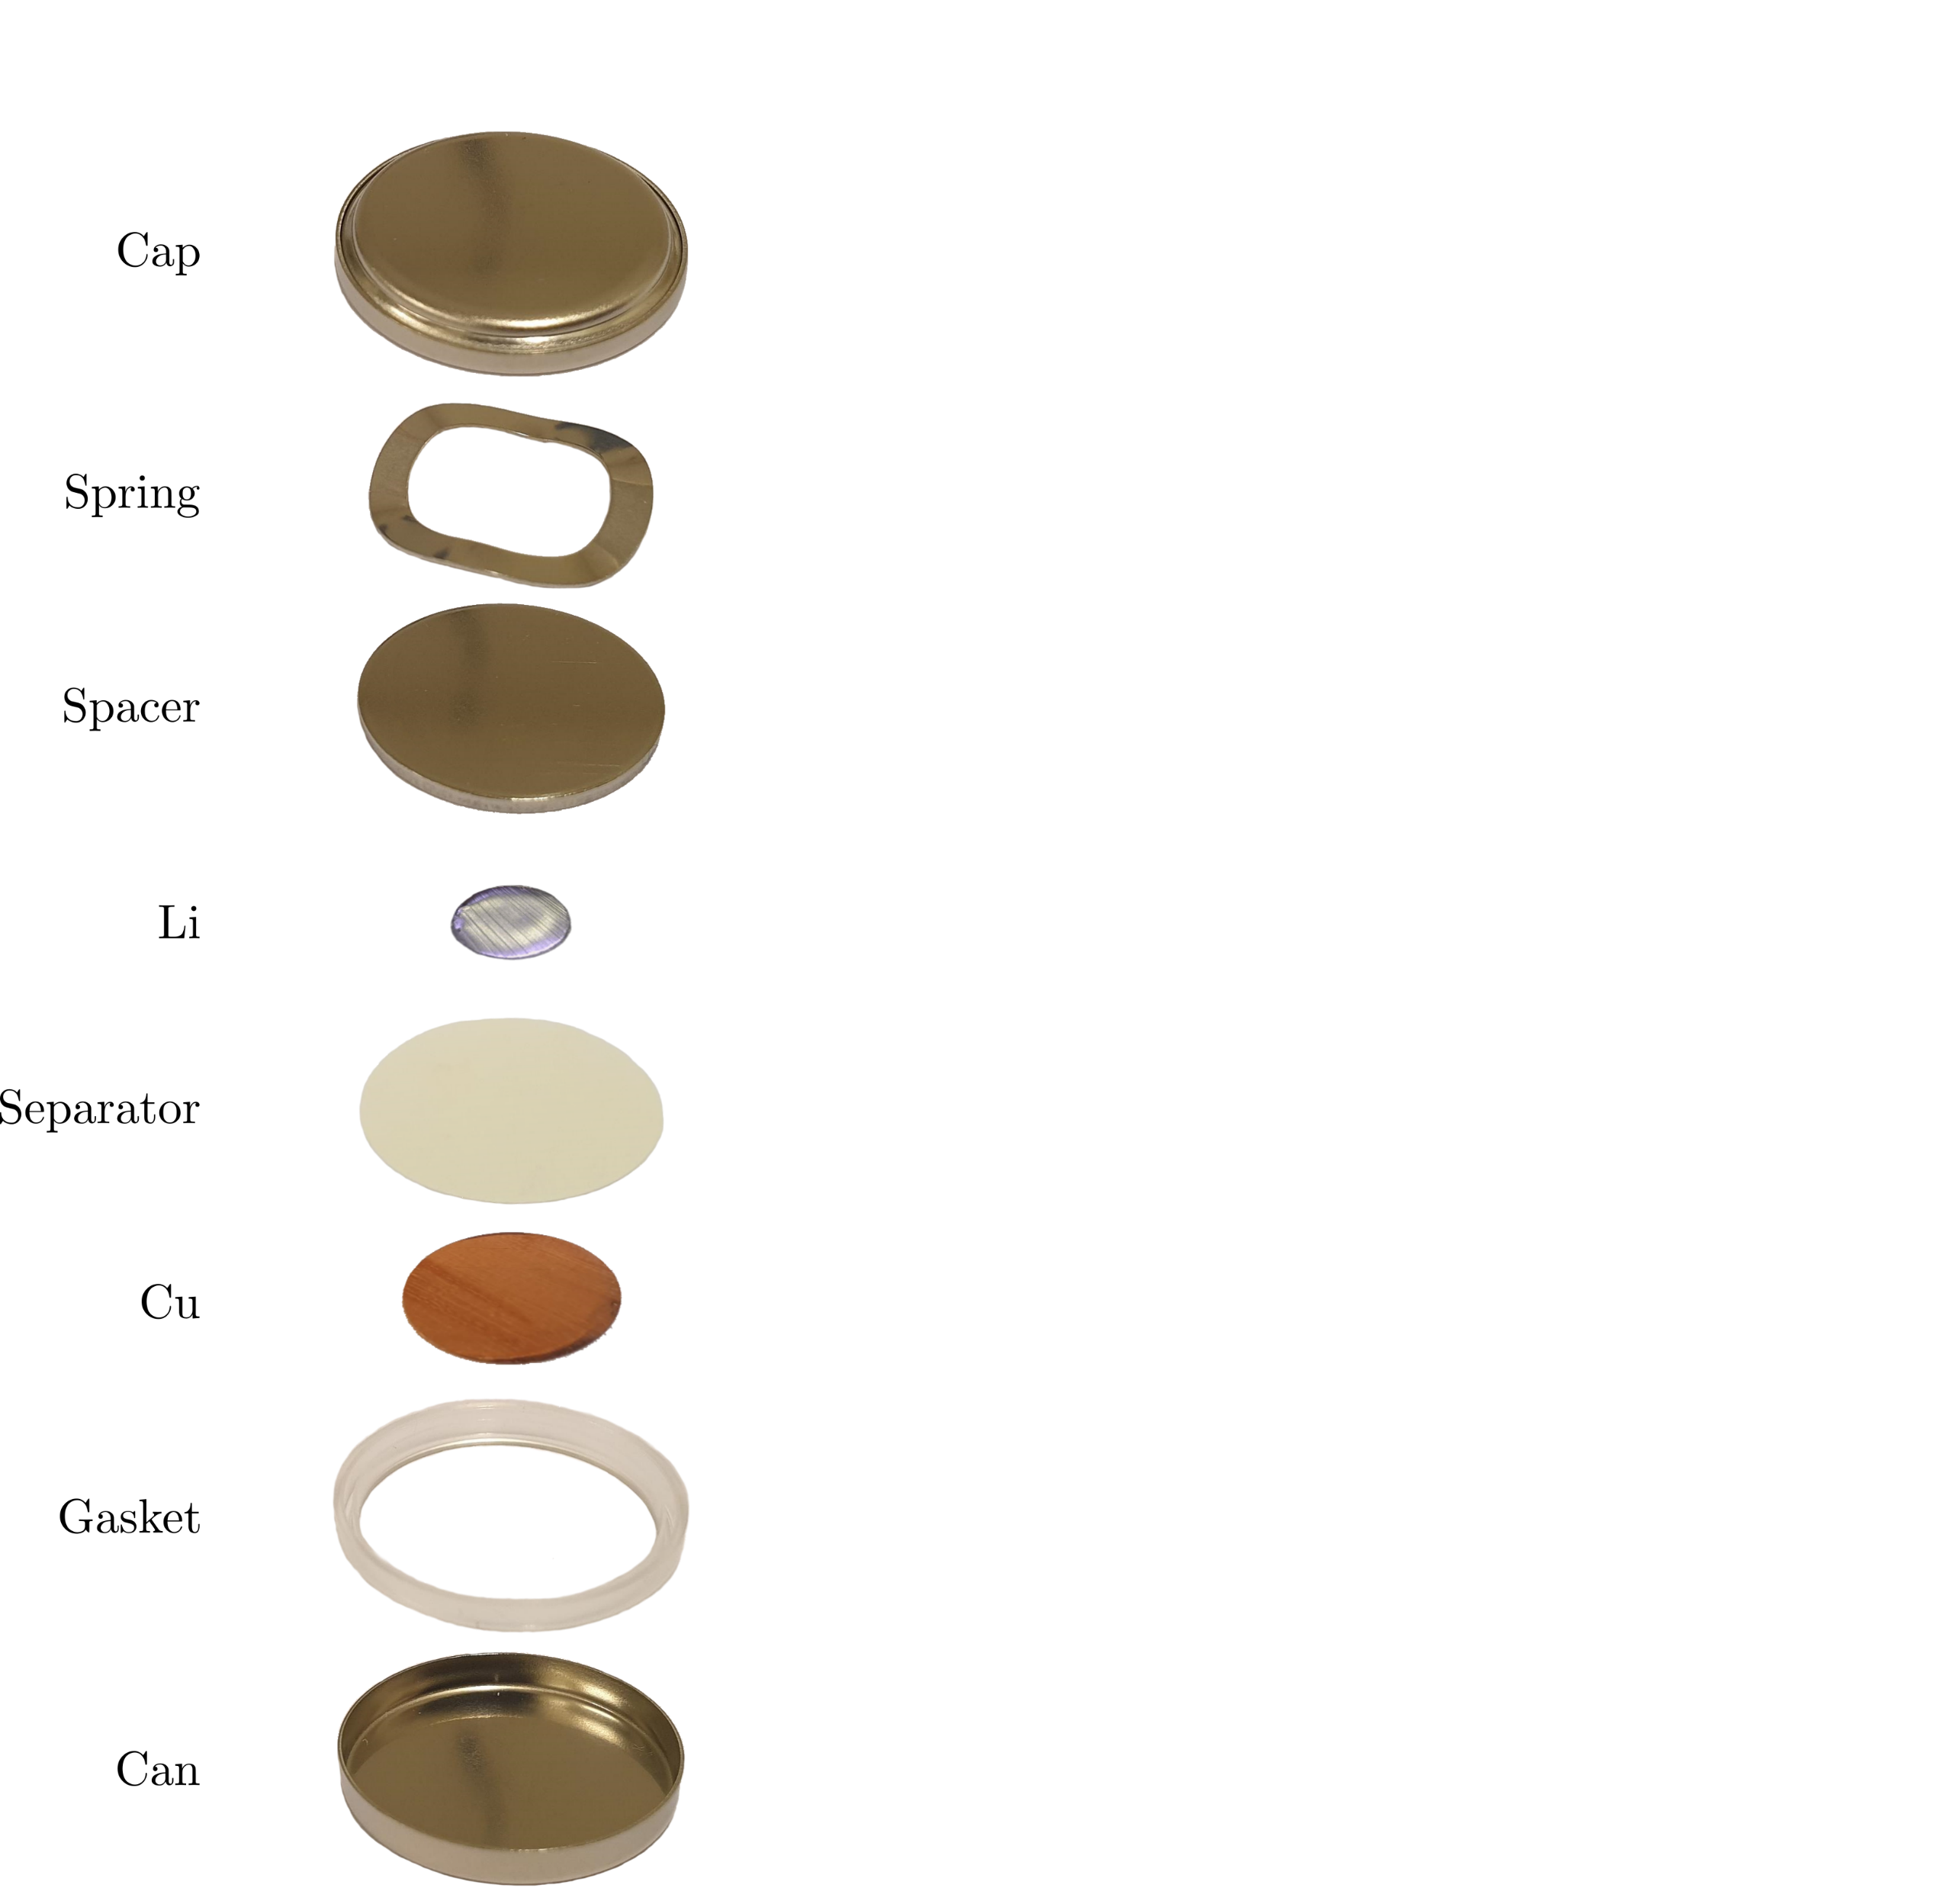
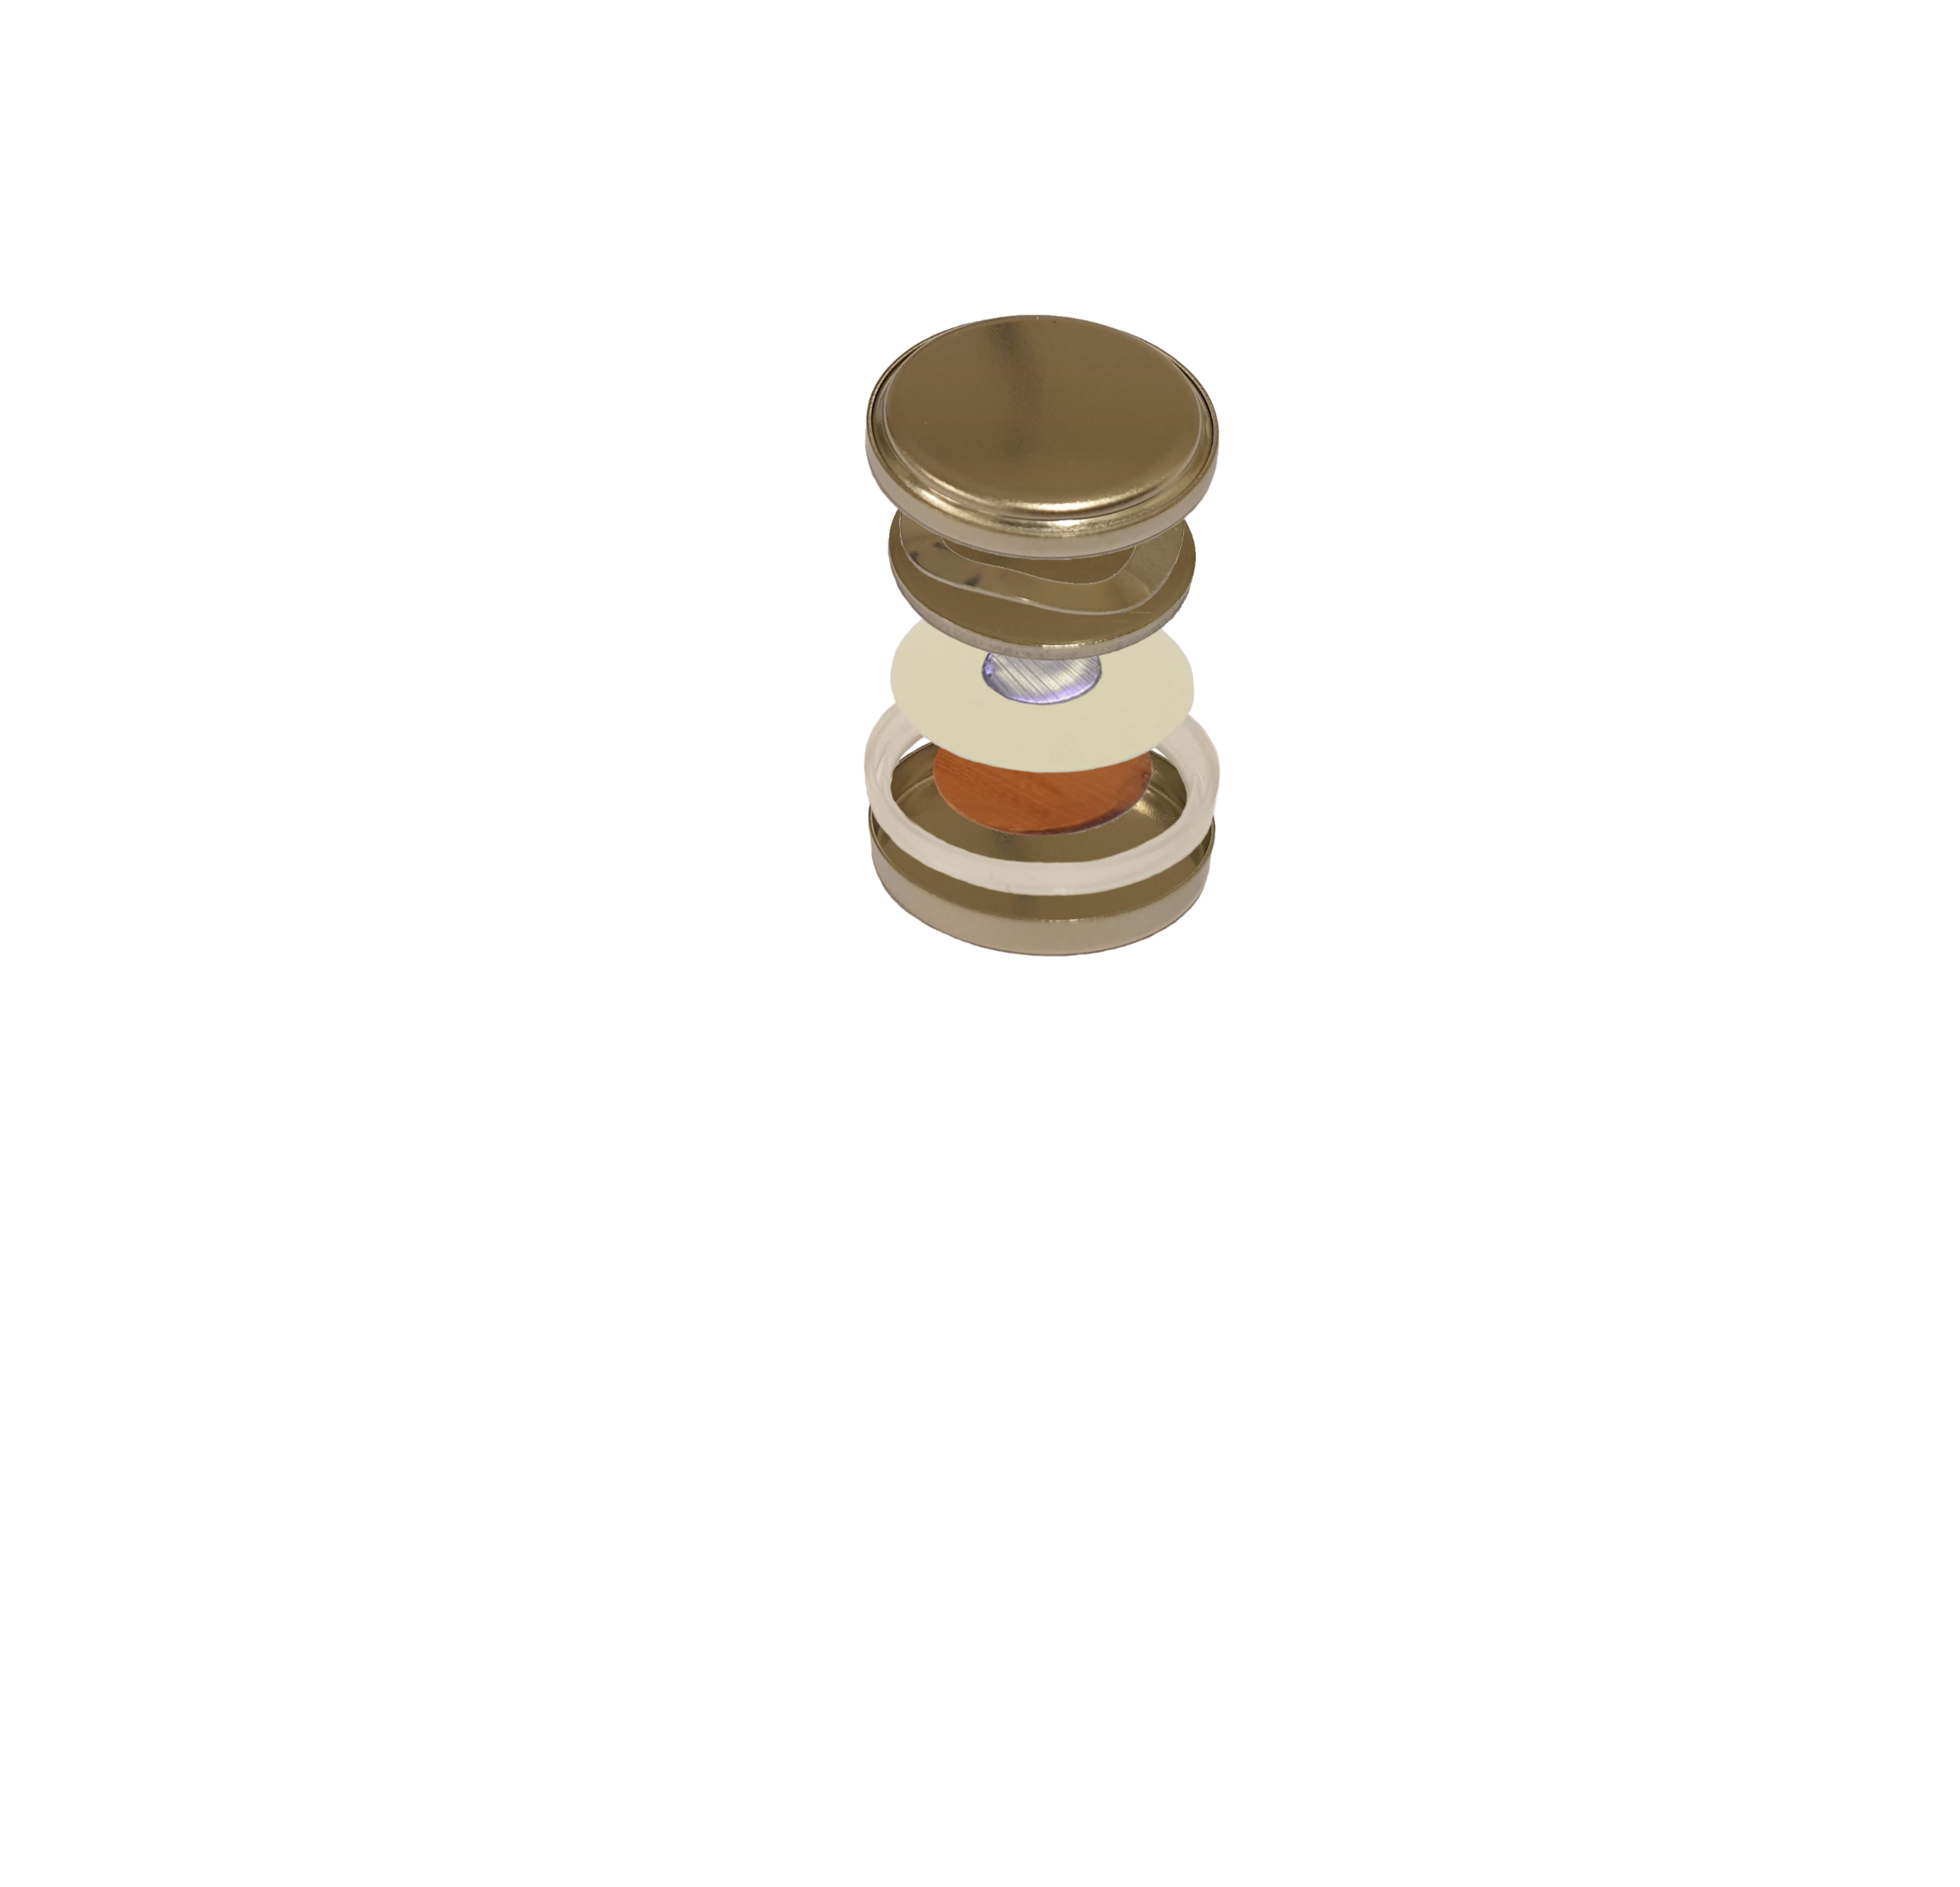
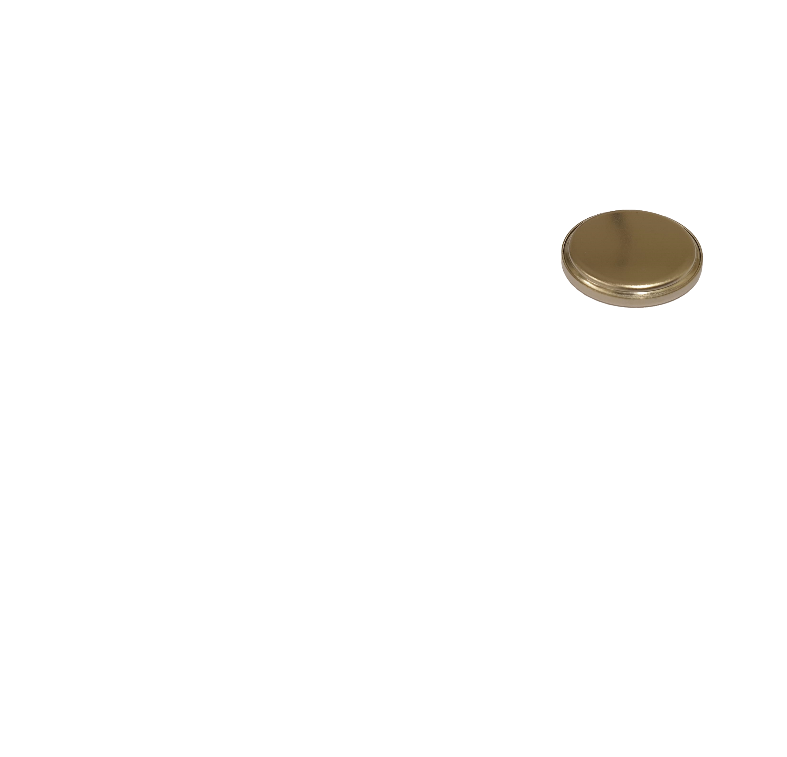
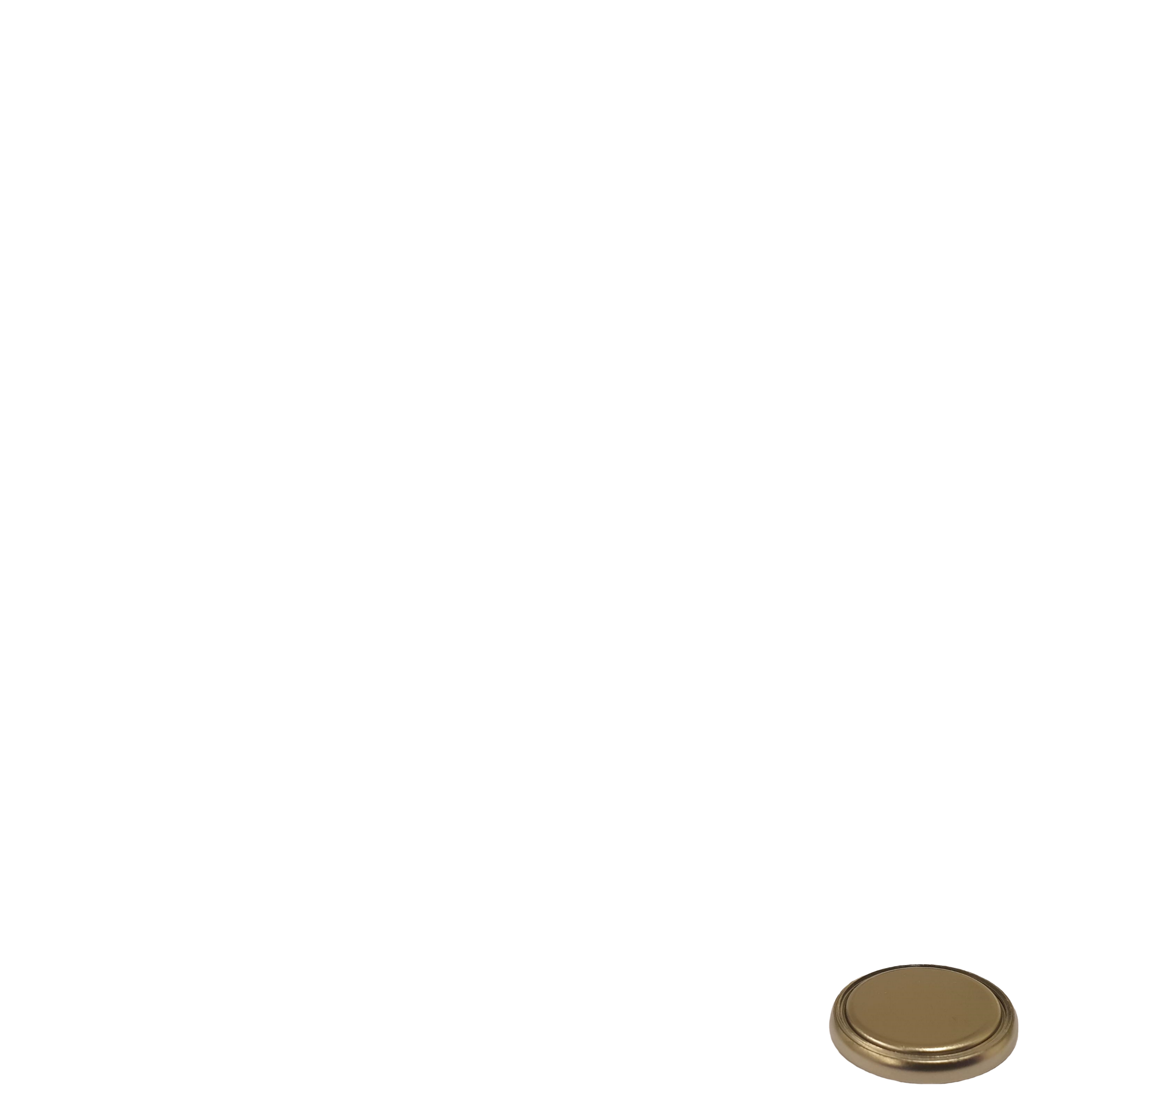
The C-cell
Cap
Spring
Spacer
Li
Separator
Cu
Gasket
Can

Slide 11
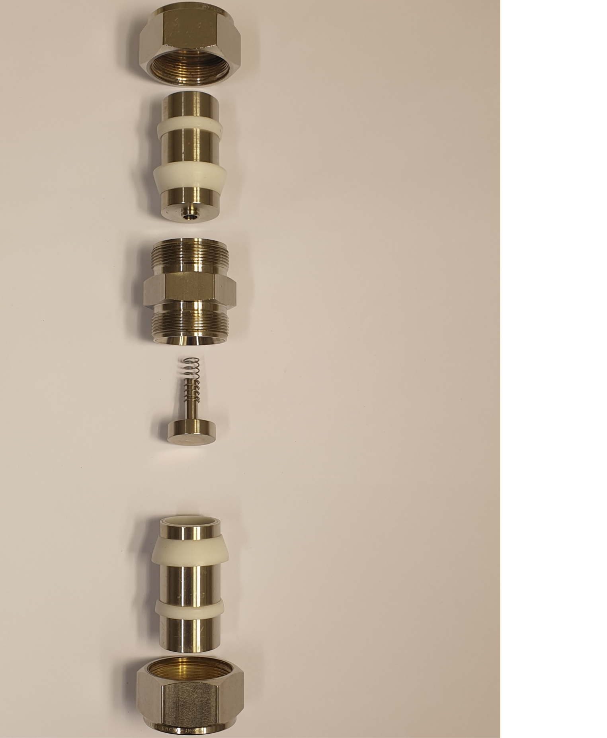
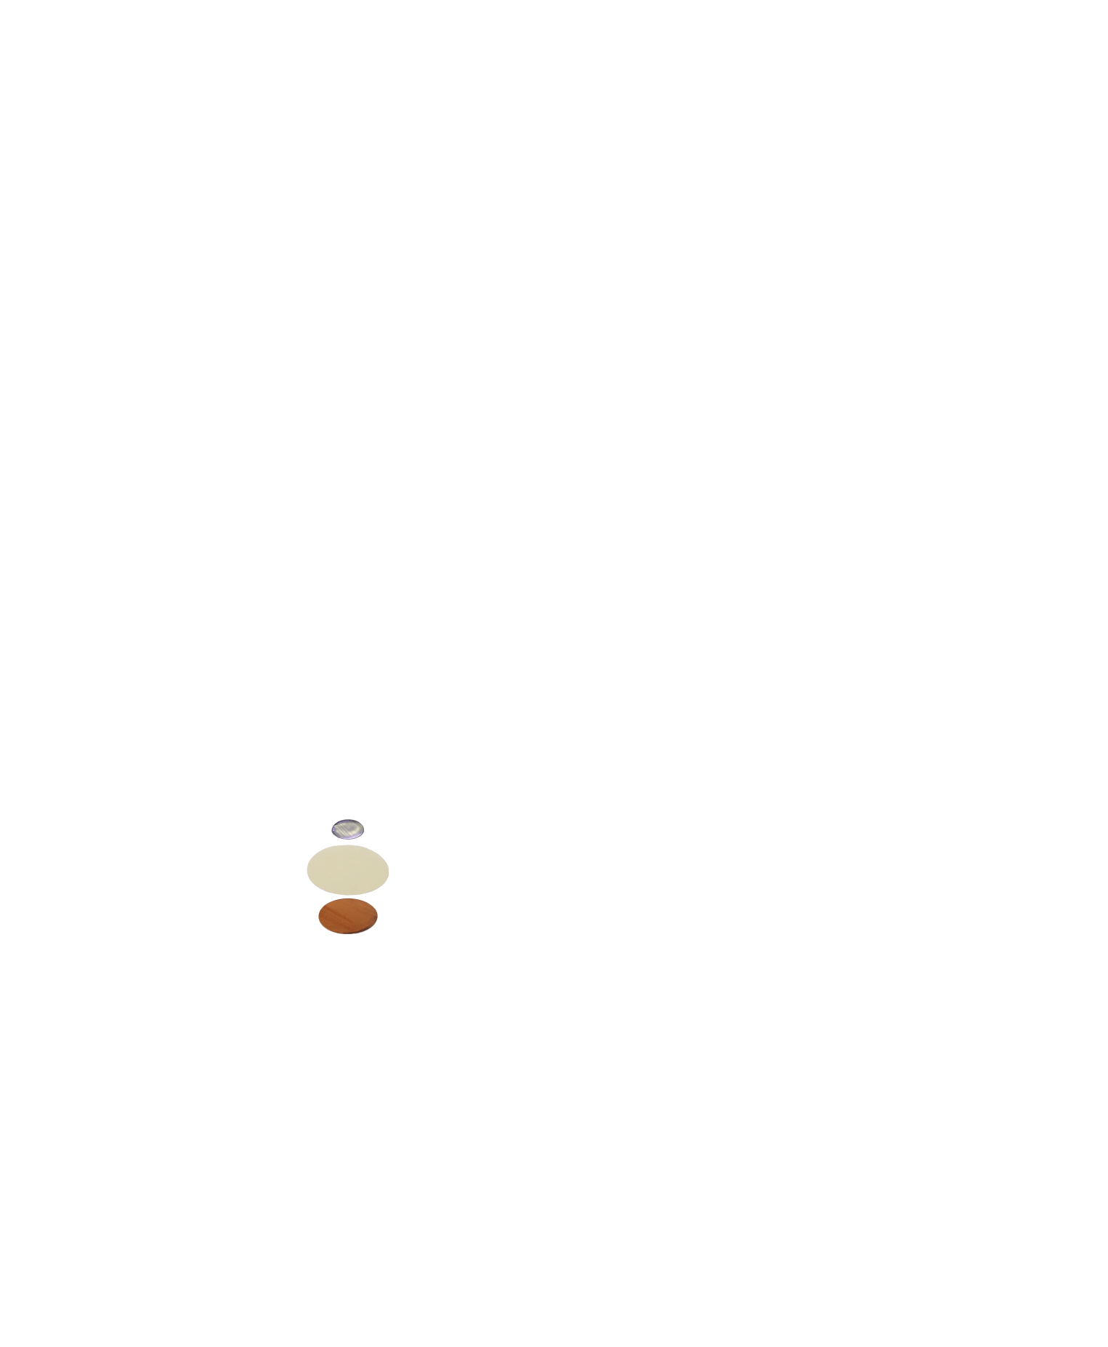
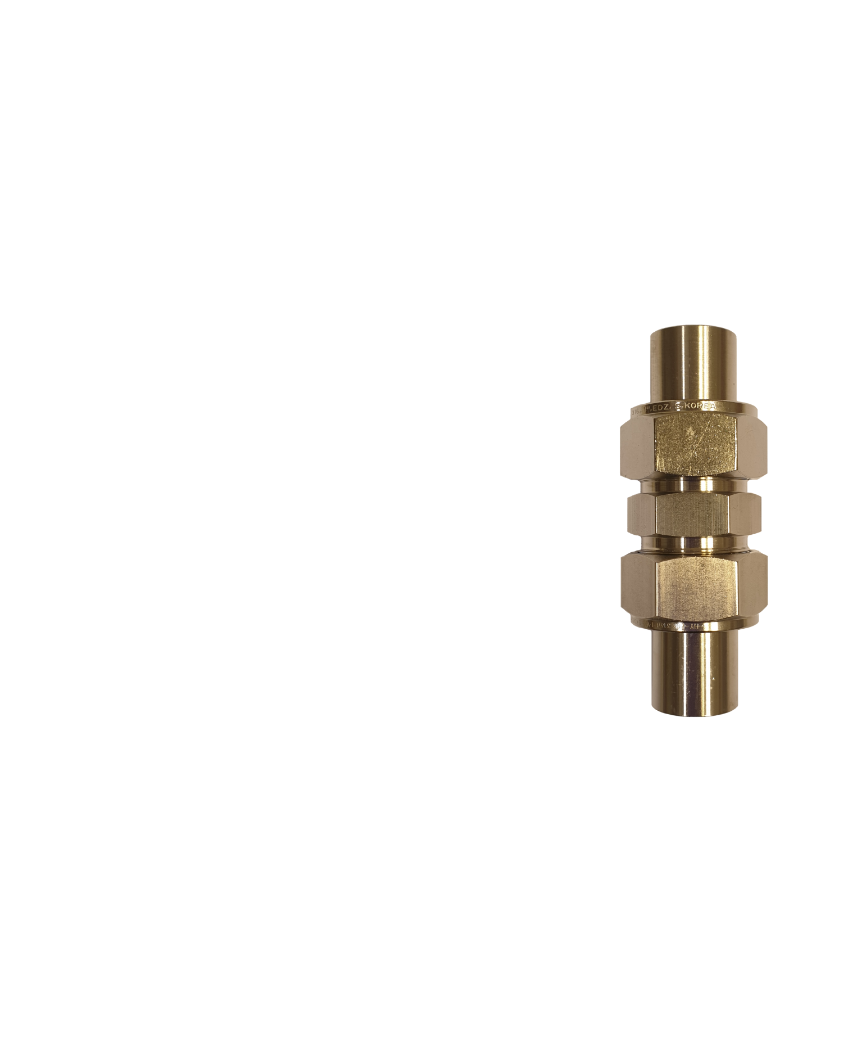
The I-cell
Nut
Metal rod
Main body
Spring
Separator
Sealing rings
Spacer
Li
Cu

Slide 12
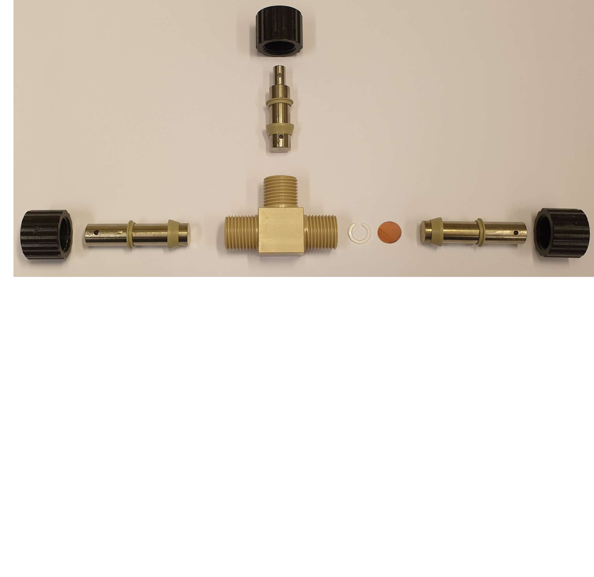

The T-cell
Nut
Metal rod
Sealing rings
Li
Main body
Spacer
Cu

Slide 13
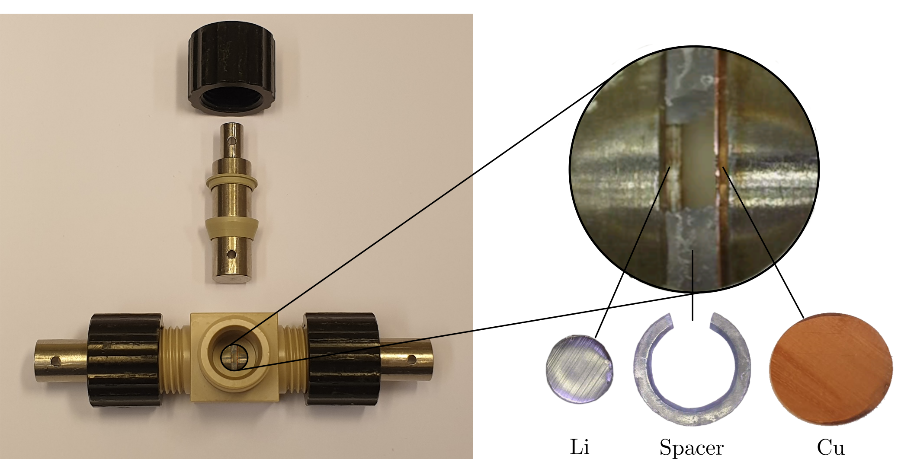
The T-cell

Slide 14
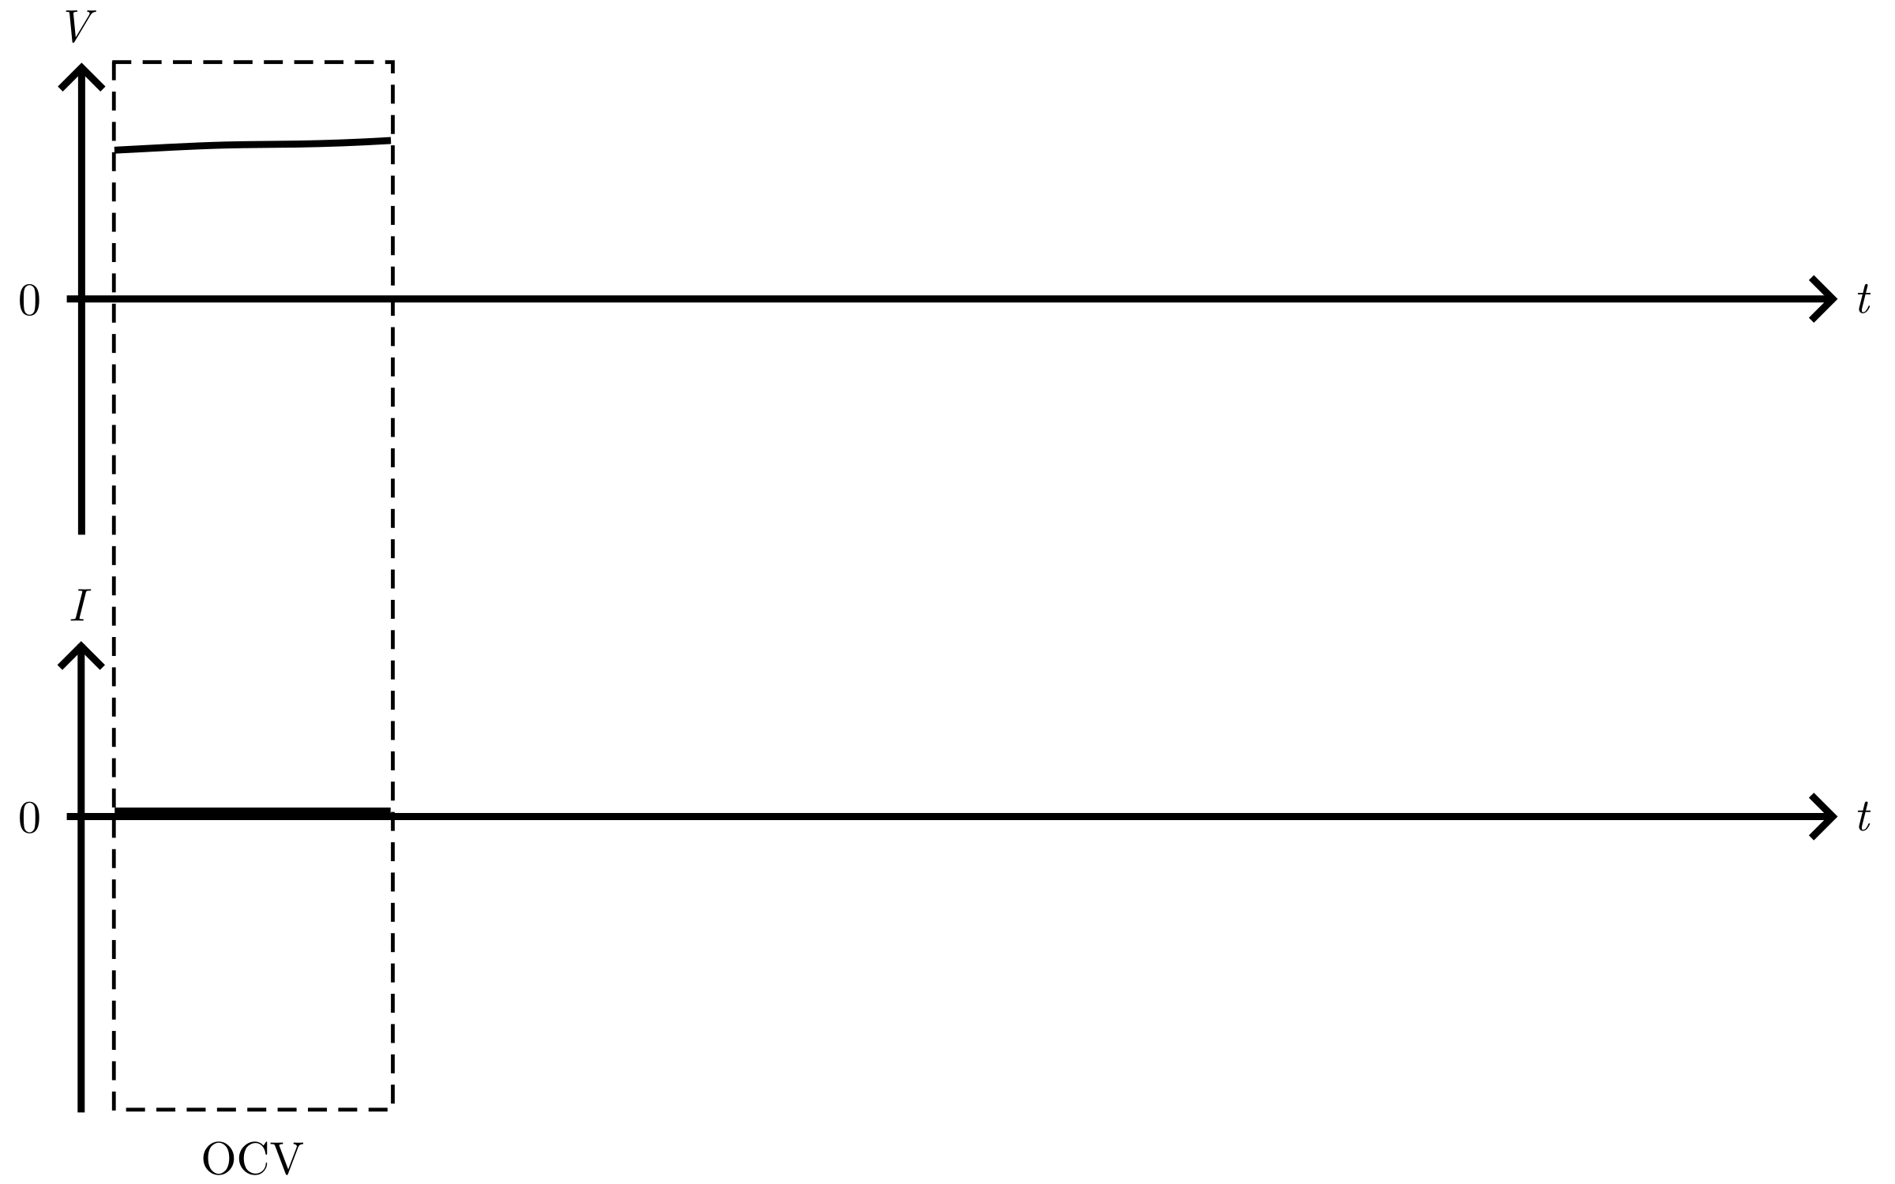
Cycling protocol

Slide 15
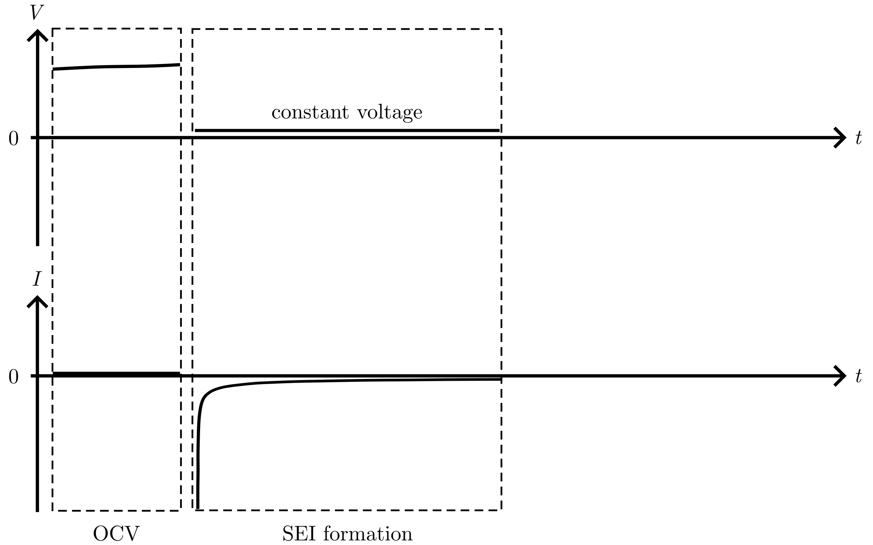
Cycling protocol

Slide 16
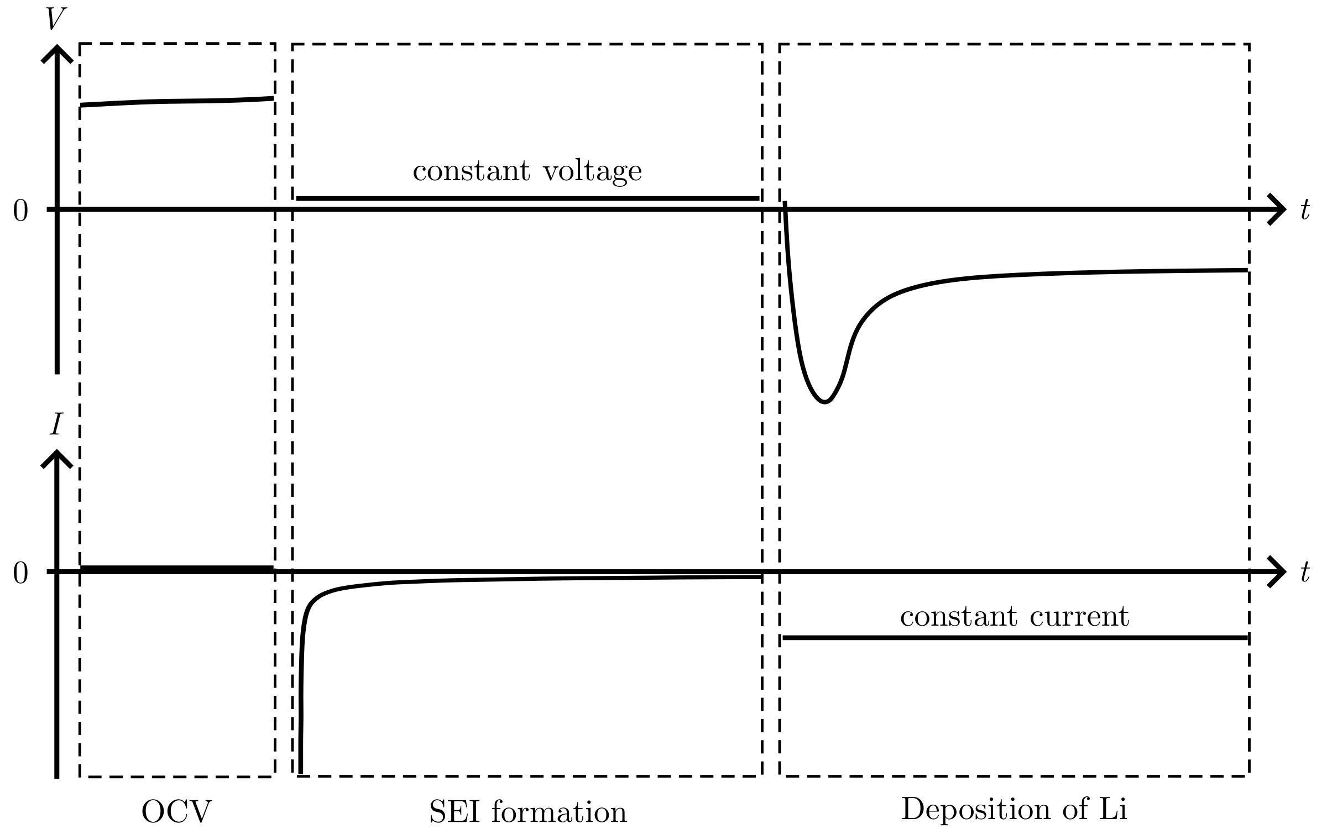
Cycling protocol

Slide 17
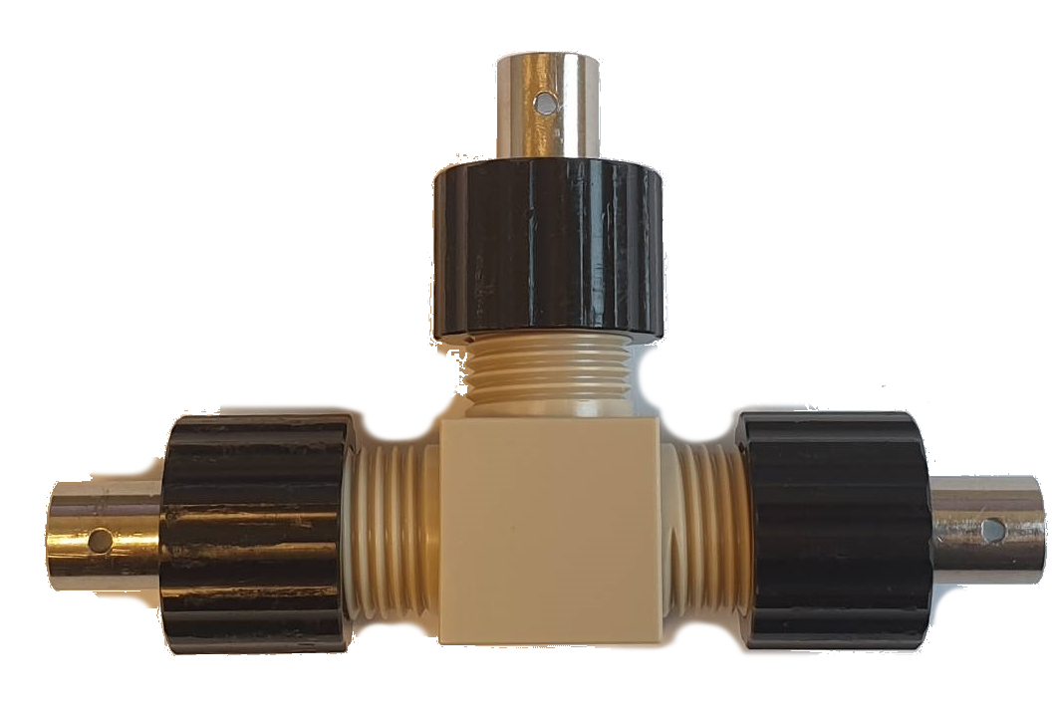
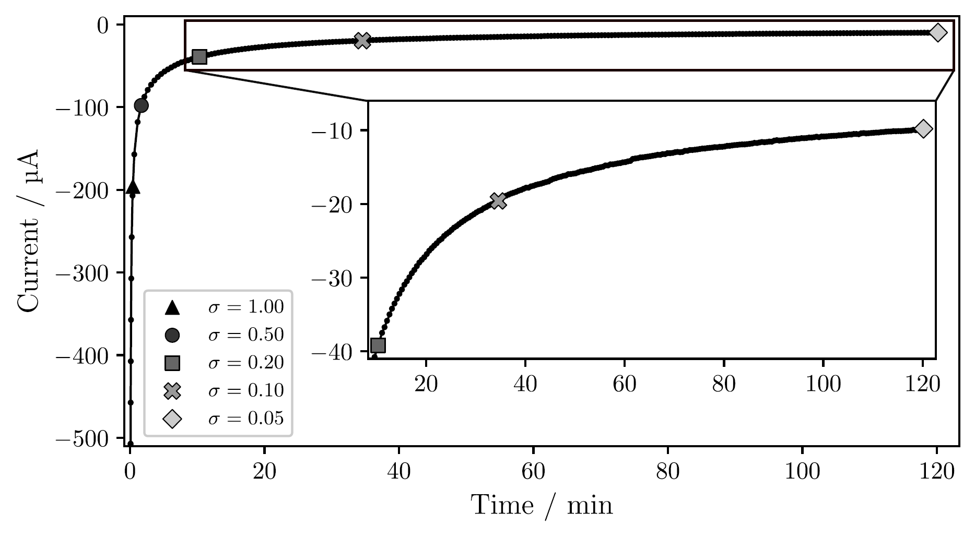
Passivation of the Cu surface
Notes:
T-cell, Jdeposition = 1 mAh/cm²
Time increase for lower sigma: 2 min for 0.50, 2 hour for 0.05, over 25 hours for 0.01

Slide 18
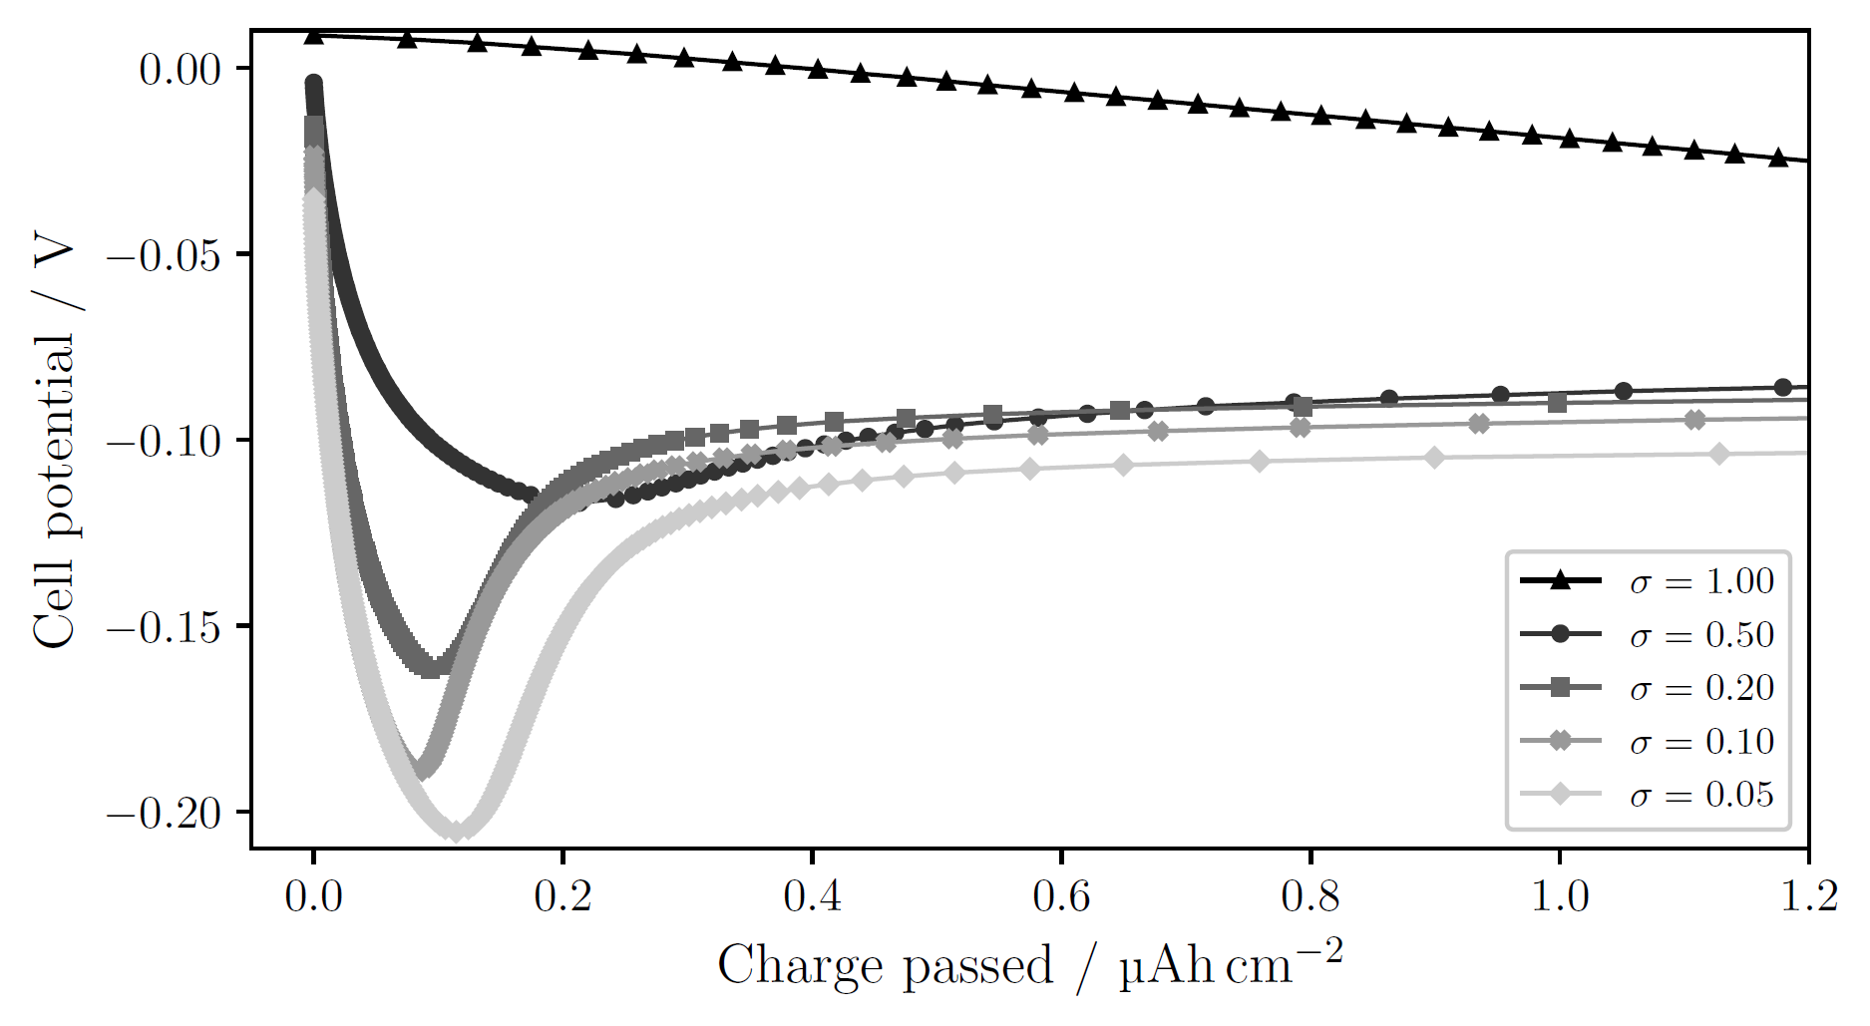
Passivation of the Cu surface
Notes:
T-cell, 1 mAh/cm²
sigma=1.00: no obvious nucleation; side reactions large enough to drive current without need for nucleation
Decreasing sigma → clearer deposition peak at higher overpotential
Larger overpotential → smaller nuclei, larger N → many sites for continued growth, lowering the necessity for further nucleation. Other words: more instantaneous nucleation (all nuclei form at the start and then they only grow).
Opposed to progressive nucleation, where nuclei continue to form as other grow

Slide 19
Different deposition currents

Slide 20
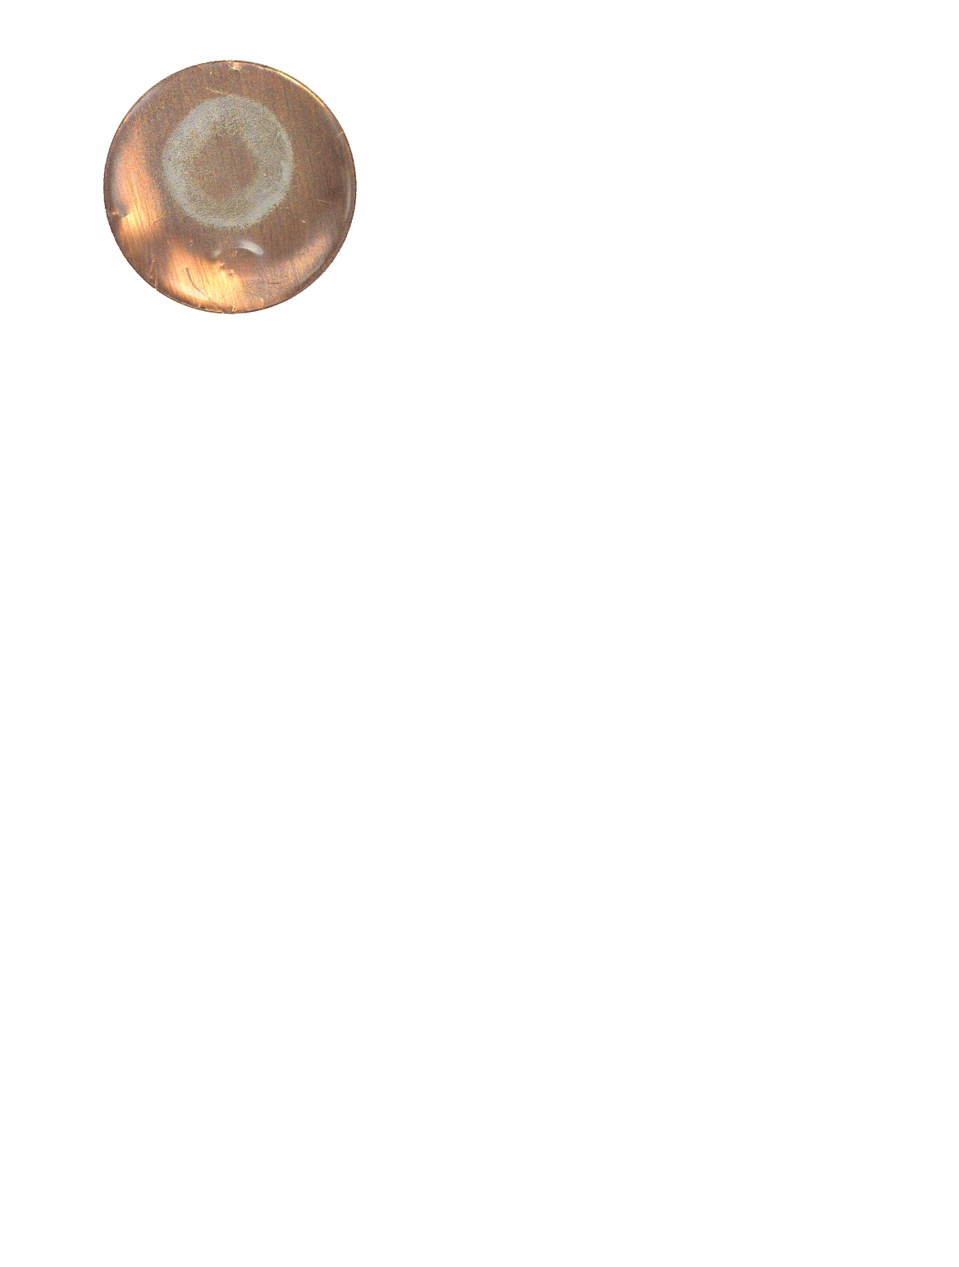
Pressure effects

Slide 21
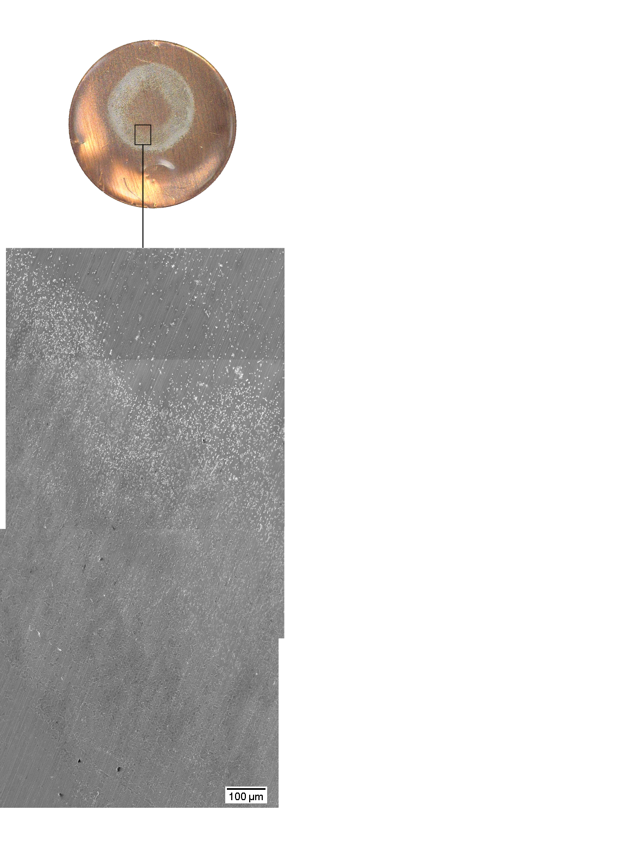
Pressure effects

Slide 22
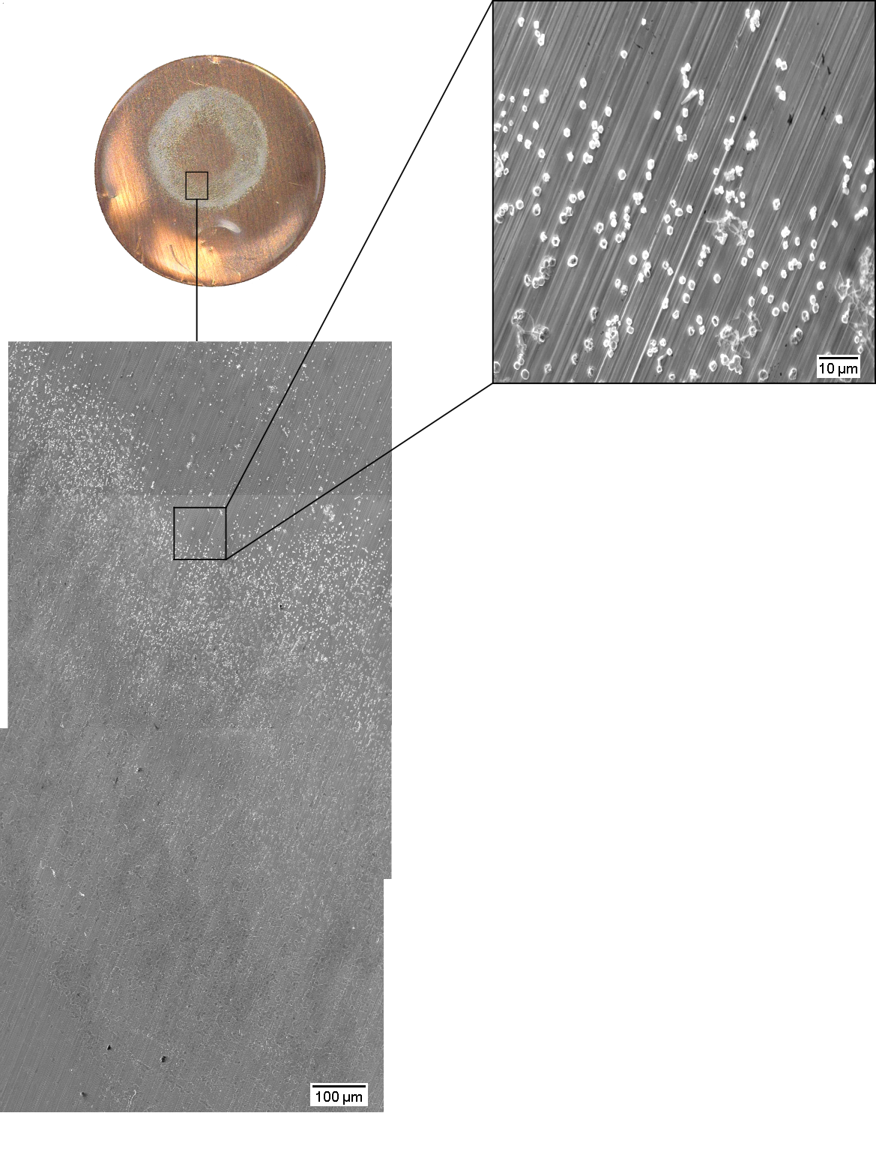
Pressure effects

Slide 23
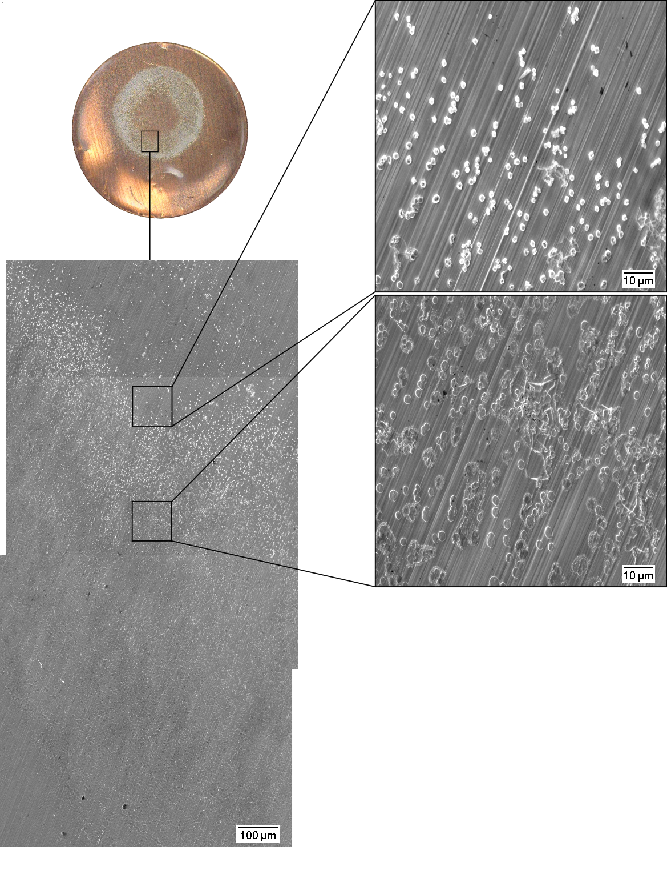
Pressure effects

Slide 24
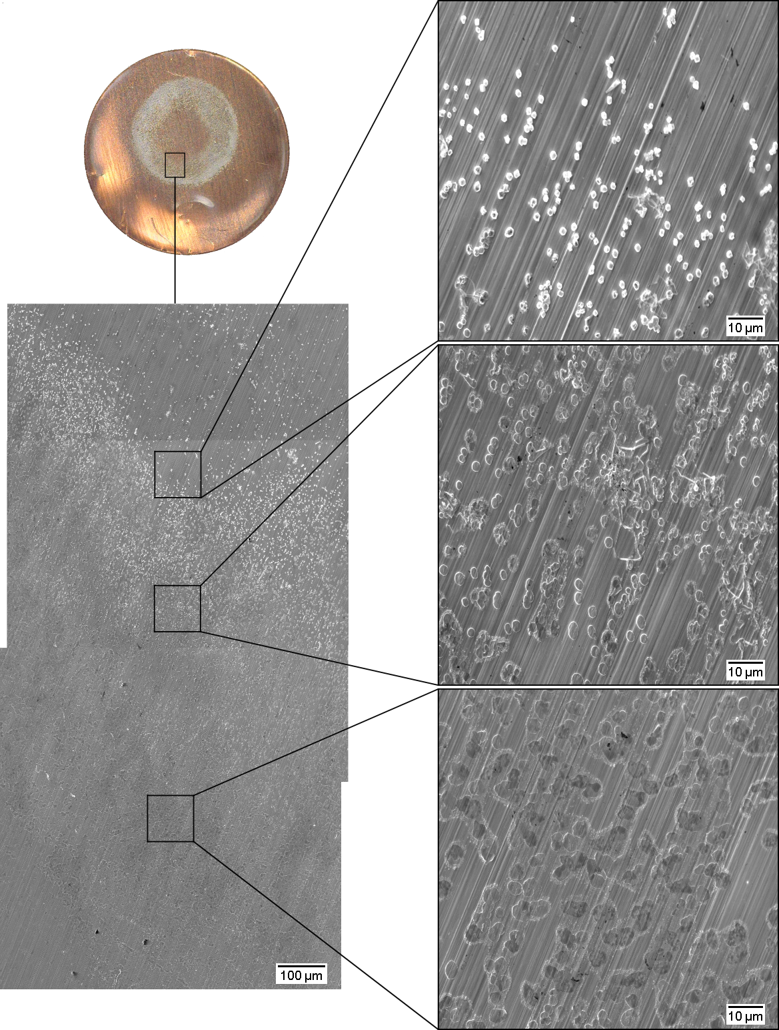
Pressure effects

Slide 25
Pressure effects
2r = 1 µm
2r = 2 µm to 3 µm
2r ≥ 4 µm

Slide 26
Pressure effects
2r = 1 µm
N = 0.024 nuclei/µm²
2r = 2 µm to 3 µm
N = 0.022 nuclei/µm²
2r ≥ 4 µm
N = 0.016 nuclei/µm²

Slide 27
Pressure effects

Slide 28
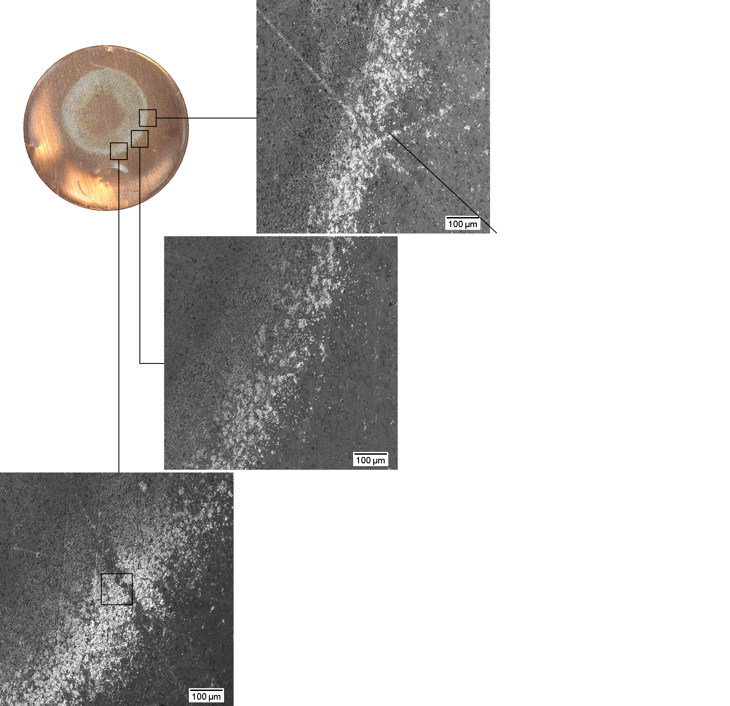
Pressure effects

Slide 29
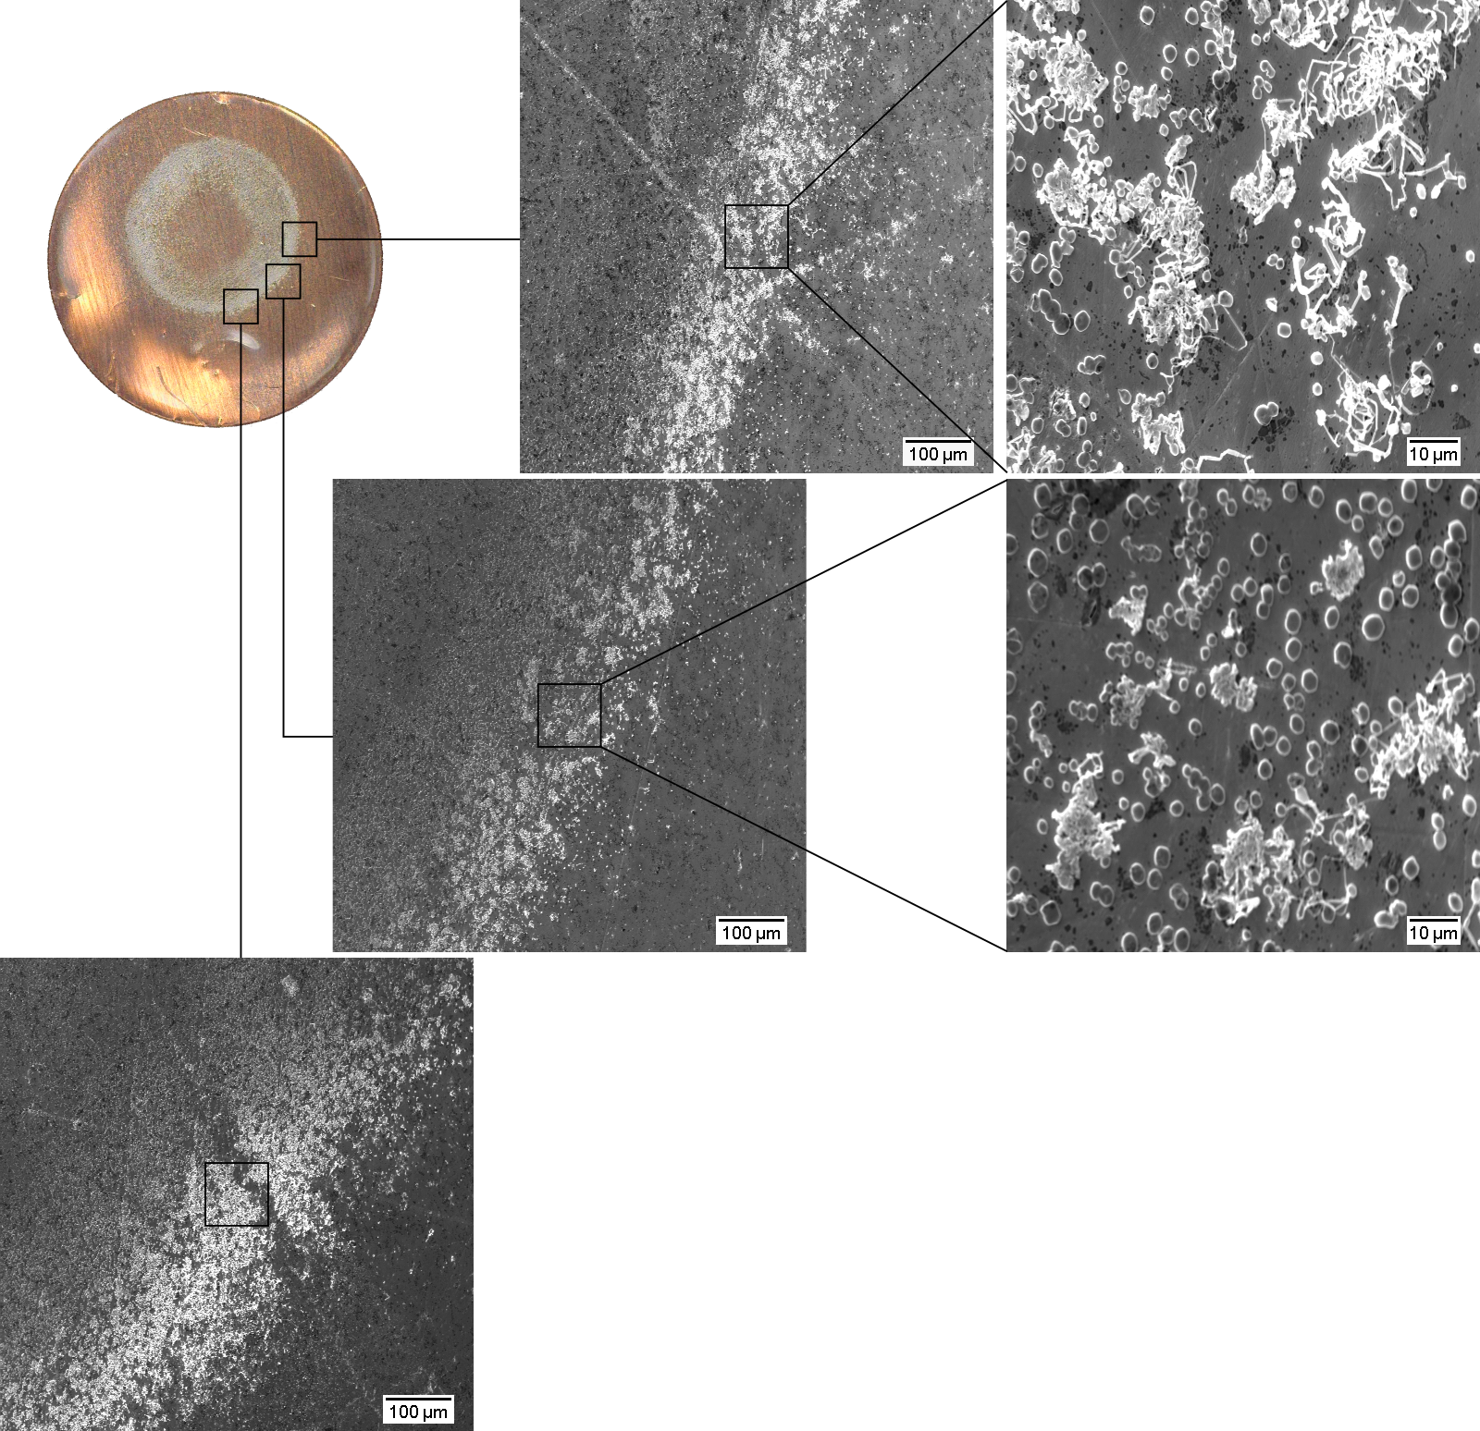
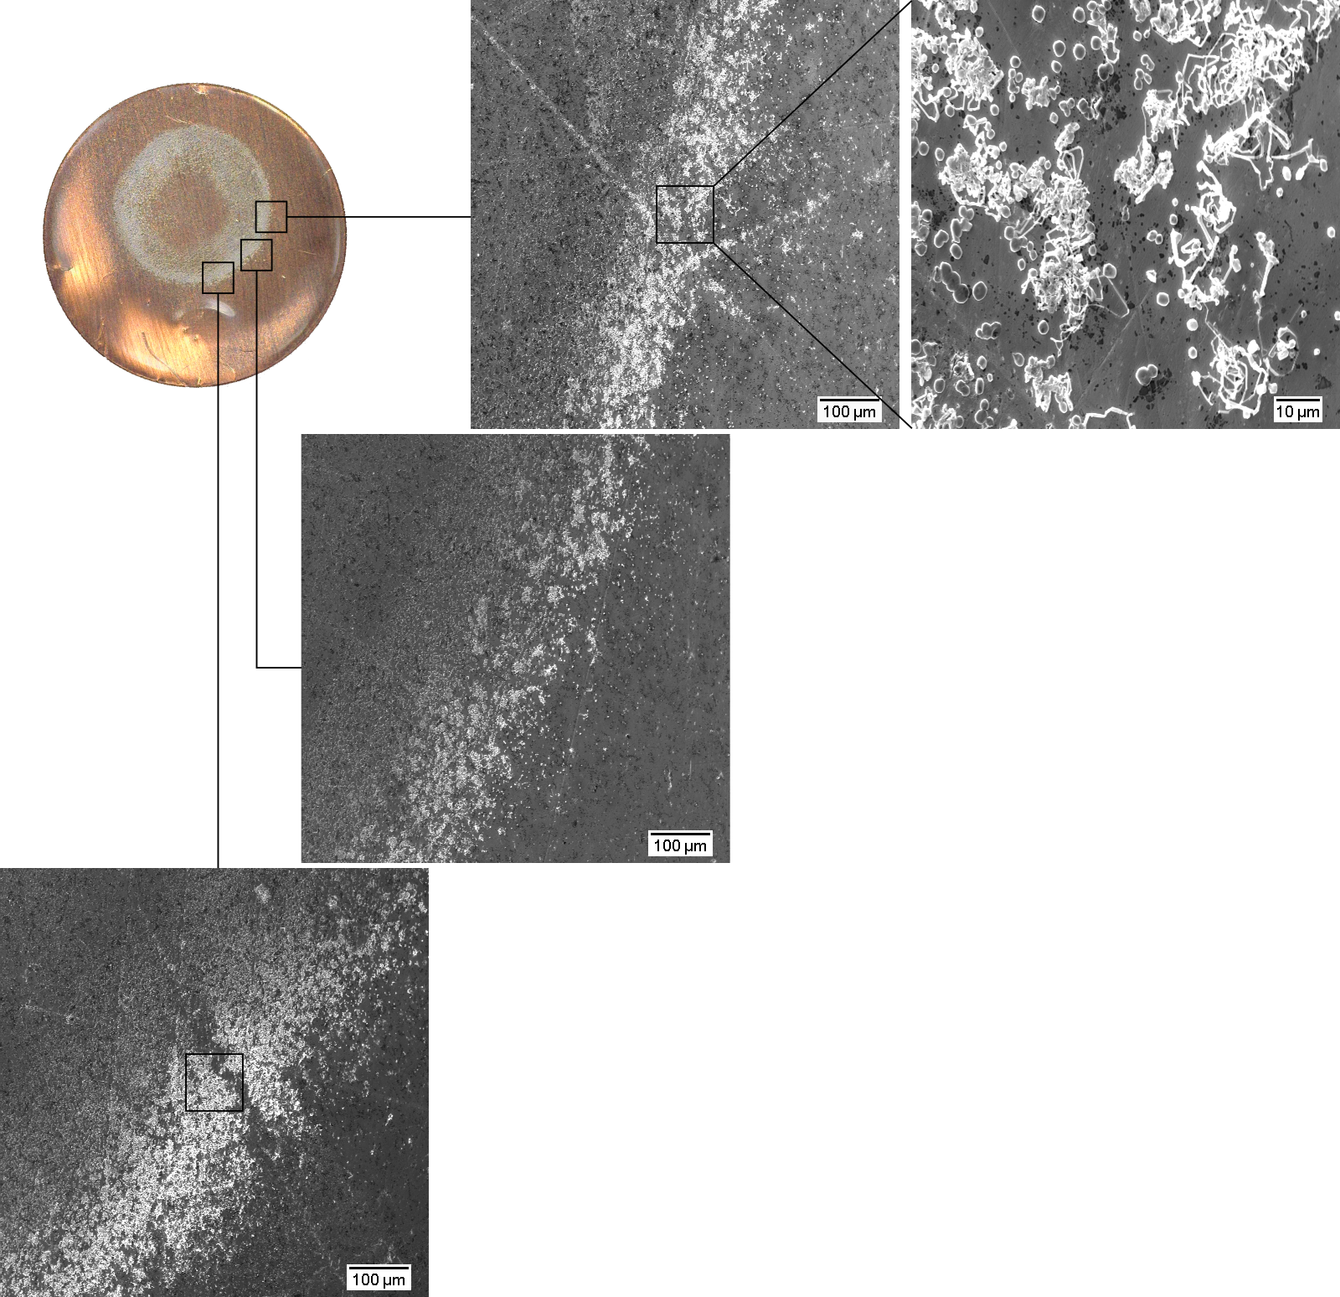
Pressure effects

Slide 30
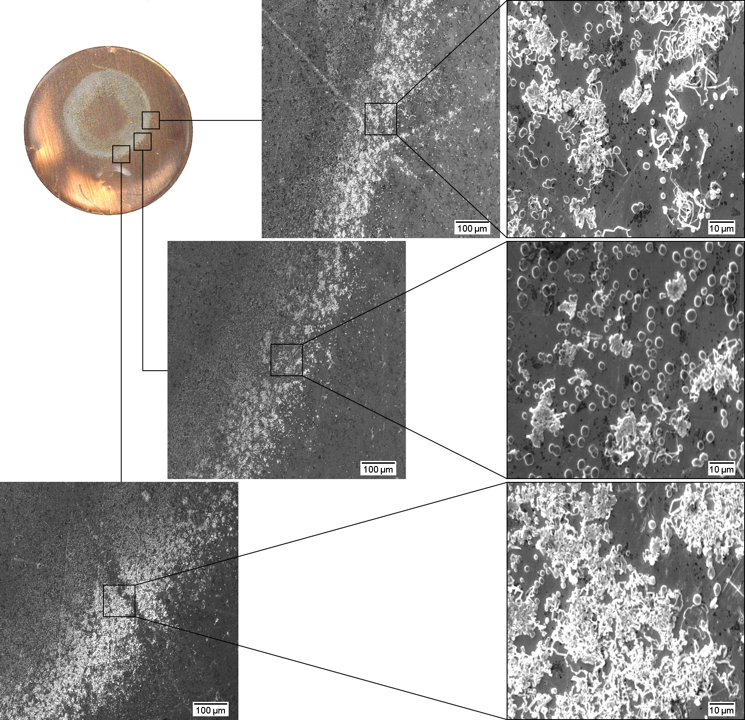
Pressure effects

Slide 31
Pressure effects

Slide 32
Pressure effects

Slide 33
Pressure effects

Slide 34
Pressure effects

Slide 35
Conclusions

Slide 36
//
Tank for listen.

Slide 37
Electrochemical deposition of lithium on copper
Gottfrid Olsson
2024-05-21

